Slide 1
AI-Driven NLP System
Campus Navigation and Student Assistance Tool

Slide 2

Introduction
This presentation discusses an AI-driven Natural Language Processing (NLP) system designed specifically for campus navigation and student assistance. It highlights the system's definition, core components, and the benefits it brings to the educational environment.

Slide 3
01
Overview

Slide 4

Definition of AI-driven NLP System
An AI-driven NLP system utilizes artificial intelligence and natural language processing techniques to interpret, understand, and respond to human language. This system provides a seamless interaction between users (students and staff) and complex software, allowing for intuitive campus navigation and personalized assistance for student needs.

Slide 5
Key Components
The key components of the AI-driven NLP system include advanced algorithms for understanding natural language, machine learning capabilities to improve responses over time, integration with campus digital infrastructure, real-time data processing for information retrieval, and user-friendly interfaces designed for diverse user access, including multilingual support.

Slide 6
Benefits of AI in Campus
AI enhances the campus environment by providing efficient navigation, personalized student assistance, and streamlined operations. The system can make real-time adjustments based on data, improving the overall experience for students and faculty. It supports multilingual communication, ensuring inclusivity, and can adapt based on user feedback, continuously improving its effectiveness.

Slide 7
02
Navigation

Slide 8
Real-Time Location Tracking
Real-time location tracking serves as a pivotal feature, enabling users to receive live updates about their location and navigate the campus effortlessly. This functionality can be integrated with mobile devices, allowing students to find their way to classrooms, libraries, and other facilities with precision. Moreover, it supports safety initiatives by ensuring users can be located quickly in emergencies.

Slide 9
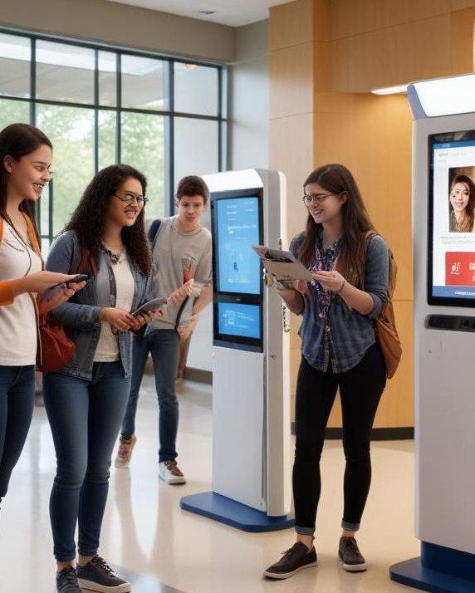
User-Friendly Interface
The user-friendly interface is designed to promote accessibility and ease of use. With intuitive navigation and clear visual cues, students and staff can interact with the system without extensive training. The layout incorporates icons and simple language to minimize confusion, and features voice assistance to support users who may require help. This ensures an inclusive environment for all campus users.

Slide 10
3D Campus Maps
3D campus maps offer an interactive way for users to explore the campus layout. These maps provide detailed visualizations of buildings, pathways, and landmarks, making navigation straightforward. Integration with the real-time tracking system allows users to visualize their current location and plan routes effectively. Furthermore, 3D maps can enhance engagement through gamification elements, attracting student interest.

Slide 11
Conclusions
The AI-driven NLP system transforms campus navigation and student assistance, offering a futuristic solution that enhances the educational environment. By leveraging real-time data, user-centric design, and advanced mapping, it addresses myriad challenges faced by students and staff, paving the way for a more efficient and smarter campus experience.

Slide 12

Thank you!
Do you have any questions?

